Slide 1
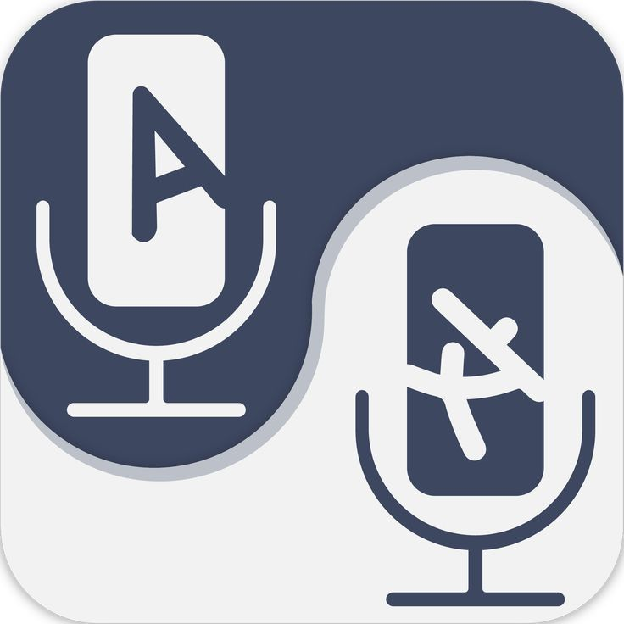
TEAM SHADOW SCRIPTS
SAITEJA JINDE
OMKAR TAVVA
ADARSH
SRI HARSHA
VIGNANA BHARATHI INSTITUTE OF TECHNOLOGY

Slide 2

ORGANISING A MEETING WITH LANGUAGE VIRTUAL INTERPRETATION
A major issue faced in virtual meetings regarding language during the communication is:
Language Barriers
Different participants may speak different languages, leading to language barriers and difficulties in effective communication.
This can result in misunderstandings, miscommunication, or exclusion of participants who do not understand the dominant language of the meeting.

Slide 3
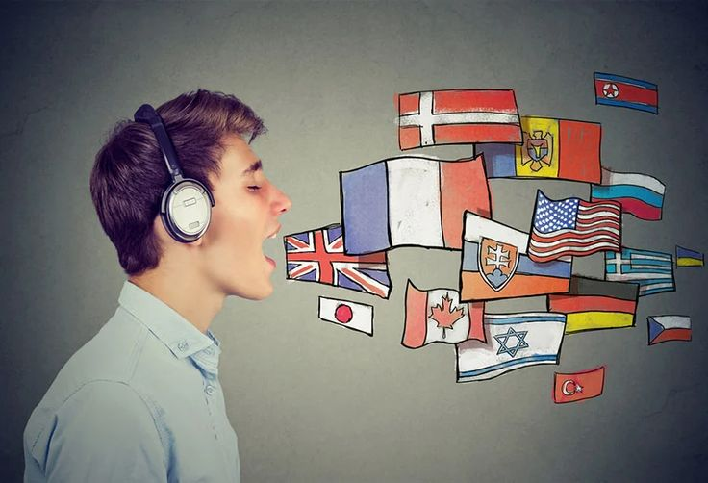
OBJECTIVES
Enable Multilingual Communication:
Facilitate seamless communication among participants who speak different languages by providing real-time interpretation services through virtual platforms.
Enhance Information Sharing:
Ensure that essential information, messages, and discussions are accurately interpreted and conveyed to all participants, minimizing the risk of miscommunication or misunderstandings.
Increase Meeting Effectiveness:
Improve the overall effectiveness of the meeting by enabling participants to concentrate on the subject matter and objectives instead of language barriers.

Slide 4

PROPOSED SOLUTION
Developing a Web Extension for Language Virtual Interpretation in Meetings.
Design and Development:
Creating a user-friendly and intuitive interface that allows meeting organizers to easily set up language interpretation and participants to select their preferred language.
Develop the extension to integrate with popular video conferencing platforms (e.g., Zoom, Microsoft Teams, Google Meet) using their APIs or browser extensions.

Slide 5

TECH STACK
Our tech stack combines web development and a web extension to create a powerful and versatile solution.

Slide 6
FEATURES & FEASIBILITY
Assess the technical infrastructure and capabilities required for real-time virtual interpretation.
Evaluate the availability of qualified interpreters or virtual interpretation services to support the desired languages.
Investigate the demand for language virtual interpretation services within your target audience.

Slide 7
FUTURE SCOPE
To improve the propagation delay of the physical interpreter and to optamize the communication during a virtual meetings

